Slide 1
Windows
CardSpace
Martin Parry
Developer & Platform Group
Microsoft Ltd
Martin.Parry@microsoft.com
http://www.martinparry.com

Slide 2
Intro - .NET Framework v3.0
Shipped last year
CardSpace, WCF, WPF, WF
Supported on: -
  Windows XP SP2
  Windows Server 2003
  Windows Vista
Uses CLR v2.0, VS 2005, no language changes

Slide 3
Intro - .NET Framework v3.5
Will ship with Visual Studio 2008
Currently available in Beta 1
Enhancements to some v3.0 features, plus new bits
Still uses CLR v2.0
Visual Studio 2008
Some language additions

Slide 4
Identity - Problems
Passwords
  Too easy to crack, or too hard to remember
I want multiple identities
  Because I don’t trust all recipients the same
  Results in identity silos on the web
Banks etc. would like sign-on to be much more complex
  Human beings are the limiting factor
Nobody trusts a single organization...

Slide 5
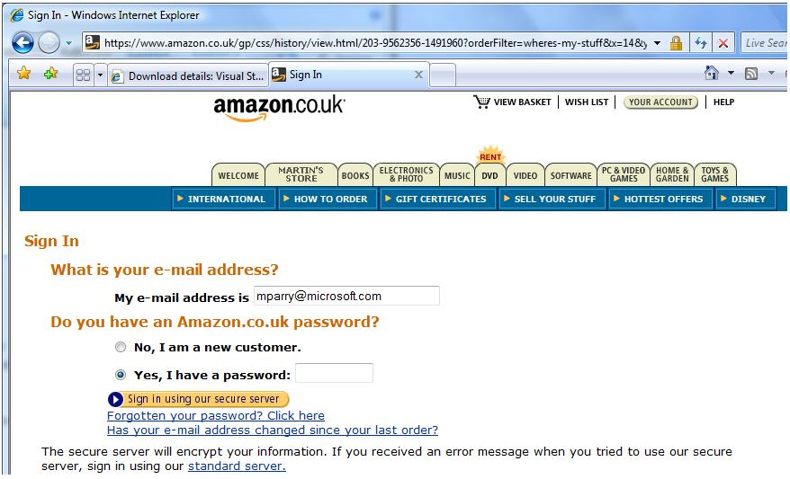
Identity – What’s the problem?

Slide 6
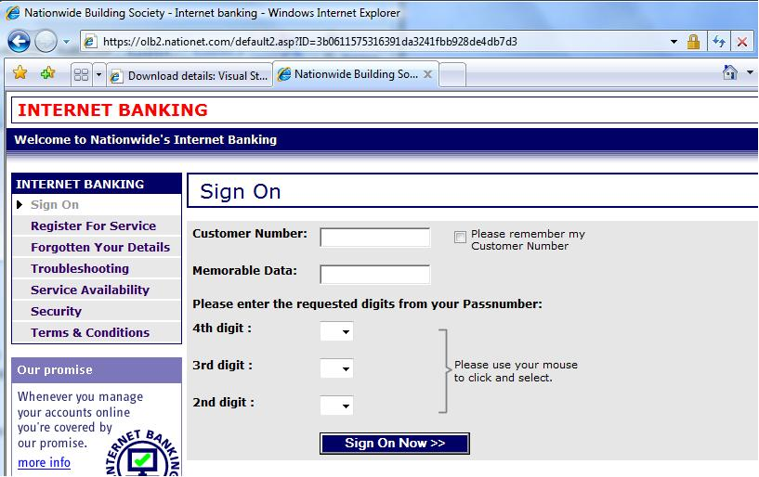
Identity – What’s the problem?

Slide 7
Identity - Solutions
Must work cross-platform
Must allow me several identities
Must put me in control of my identities
Must not put a single org. in charge
Must allow recipients to define arbitrarily complex sign-on data
...and protect the user from that complexity

Slide 8
What have we got?
WS-* specs give us cross-platform comms
SAML tokens are a standard way to exchange identity claims
Putting these together inside an open, consistent architecture gives us...
The Identity Metasystem

Slide 9



The Identity MetaSystem
Relying Party
2.
“I would like a SAML 1.1 token, containing First Name, Surname, issued by *any*”
Policy
3. UI filters cards that can satisfy policy
Access resource
7. Token is presented
4. User picks a card
6. Token is created
5. Token is requested
Identity Provider

Slide 10
Security Tokens
SAML
  Security Assertion Markup Language
  Prevailing format for credentials today
What’s in a security token?
  Collection of claims (self-asserted or verifiable)
  Token signed by issuer
Issuing a token
  Use WS-Security and WS-Trust
Consuming a token
  Verify signature, decide if issuer trusted
  Read claims (for authZ decisions)

Slide 11
Example Security Token
Given Name: Martin
Surname: Parry
Email: martin.parry@microsoft.com
Martin
Parry
martin.parry@...

Slide 12
Security Token Service
Give it something...
Username/password
X.509 Certificate
Another security token
Biometric
Etc...
Martin
Parry
martin.parry@...

Slide 13
Types of Information Card
Personal Card
  Refers to self-issued security token
  Securely stored on user’s PC
  Fixed set of claims available
Managed Card
  Refers to Identity Provider that can issue tokens
  User’s PC stores only the IP details
  Claims are extensible

Slide 14
Personal Cards
Demo

Slide 15
Federation
If users have accounts elsewhere and you trust the authentication that takes place there
  Don’t add user accounts to your system
  Accept security tokens issued elsewhere
  Establish trust between systems
WS-Federation
Think of B2B scenarios

Slide 16
Federation: example
Instead of provisioning a new user account for a partner, I’ll let her organization authenticate her
  Automate the trust relationship
  Ask user to supply a SAML token issued by a partner org
SAML token contains claims about the user
  Partner org claims that this user’s name is Alice
  Partner org claims that Alice is a Purchaser
  Partner org claims that Alice is authorized to purchase bike parts
Reduces identity management burden and latency

Slide 17
Managed Cards
Demo

Slide 18
What’s in the HTML?
<form id="form1" method="post" action="login1.aspx">
<div>
<button type="submit">Click here to sign in</button>
<object type="application/x-informationcard" name="xmlToken">
<param name="tokenType" value="urn:oasis:names:tc:SAML:1.0:assertion"/>
<param name="issuer" value="http://schemas.xmlsoap.org/ws/2005/05/identity/issuer/self"/>
<param name="requiredClaims"
value="http://schemas.xmlsoap.org/ws/2005/05/identity/claims/givenname
http://schemas.xmlsoap.org/ws/2005/05/identity/claims/surname
http://schemas.xmlsoap.org/ws/2005/05/identity/claims/emailaddress
http://schemas.xmlsoap.org/ws/2005/05/identity/claims/privatepersonalidentifier" />
</object>
</div>
</form>

Slide 19

Server-side code
protected void Page_Load(object sender, EventArgs e)
{
string xmlToken = Request.Params["xmlToken"];
if (xmlToken == null || xmlToken.Equals(""))
ShowError("Token presented was null");
else
{
TokenHelper tokenHelper =
new TokenHelper(xmlToken, "www.fabrikam.com");
givenname.Text = tokenHelper.GetClaim(ClaimTypes.GivenName);
surname.Text = tokenHelper.GetClaim(ClaimTypes.Surname);
email.Text = tokenHelper.GetClaim(ClaimTypes.Email);
}
}
Clearly all the work is in TokenHelper
Get it in the samples at www.netfx3.com

Slide 20
How to implement a RP
Update user database
  To include unique IDs from CardSpace
Create an association page
  Users can associate cards with their accounts
Update the sign-in page
  To allow the use of cards
  Can still allow other credentials
Update registration page
  To allow the use of cards

Slide 21
Summary
CardSpace
  Solving the problems associated with identity
  It’s the Identity Selector for Windows
  Part of cross-platform, open, identity metasystem

